Slide 1

CCR - Cloud CURE Renovation
Final Presentation & Discoveries
Lucas Igel-Dunn, Connor Joyce, Sam Lindsey Alex Werner, Adam Westerholm
Notes:
Sam

Slide 2

Presentation Outline
System Architecture
Cost Analysis Reporting
Archiving Guide
Installation Guide
Volunteer Reports
User Search Guide
Notes to Tim
Moving Forward
Notes:
Sam

Slide 3

Our Project Goals
Make CURESORT cost less (Achieved!)
Cost analysis of system (Achieved!)
Volunteer Feedback (Achieved!)
Archive data guide (Achieved!)
Make guides for users (Achieved!)
Ideas to Tim (Achieved!)
Make CURESORT more efficient (Missed…)
Test CURESORT remotely (Missed…)
Notes:
Sam

Slide 4
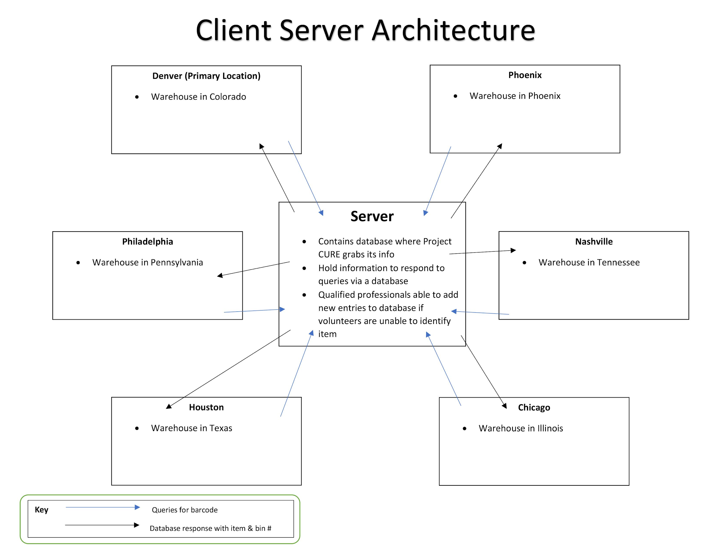
System Architecture
Notes:
Alex

Slide 5

Cost Analysis
Azure Projects:
CURESORT
DMT
Medical Tracking
Total Azure Cost in May 2019 : $574.36
How much is Project Cure spending in Azure?
Notes:
Adam

Slide 6
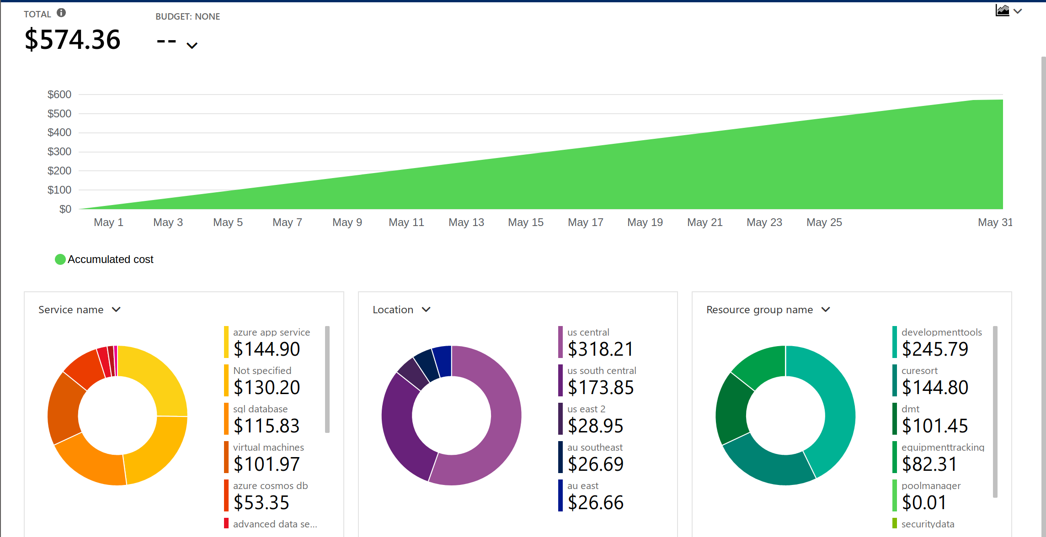
Overall Project Cure Azure Costs for May 2019
Notes:
Adam

Slide 7
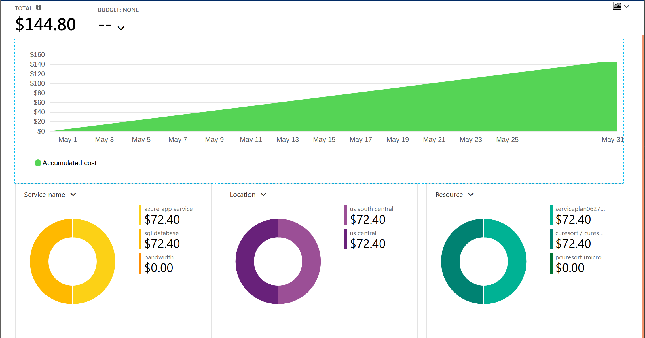
Overall Curesort Azure Costs for May 2019
Notes:
Connor

Slide 8
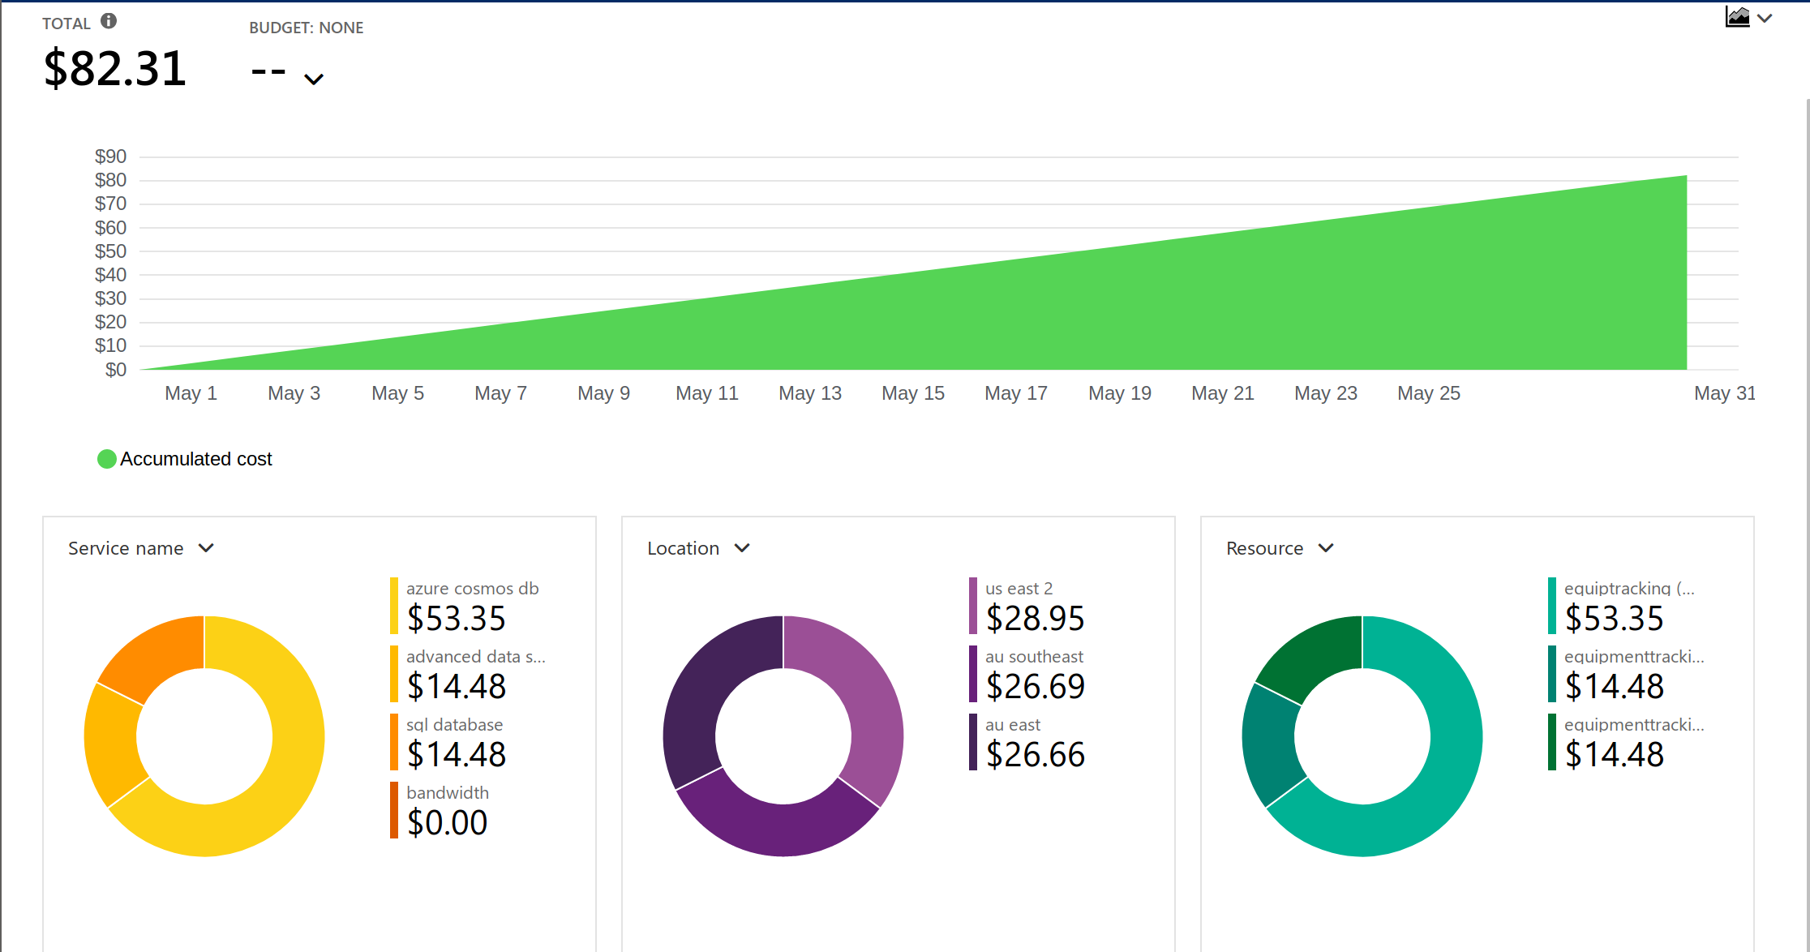
Equipment Tracking Cost for May 2019
Notes:
Adam

Slide 9
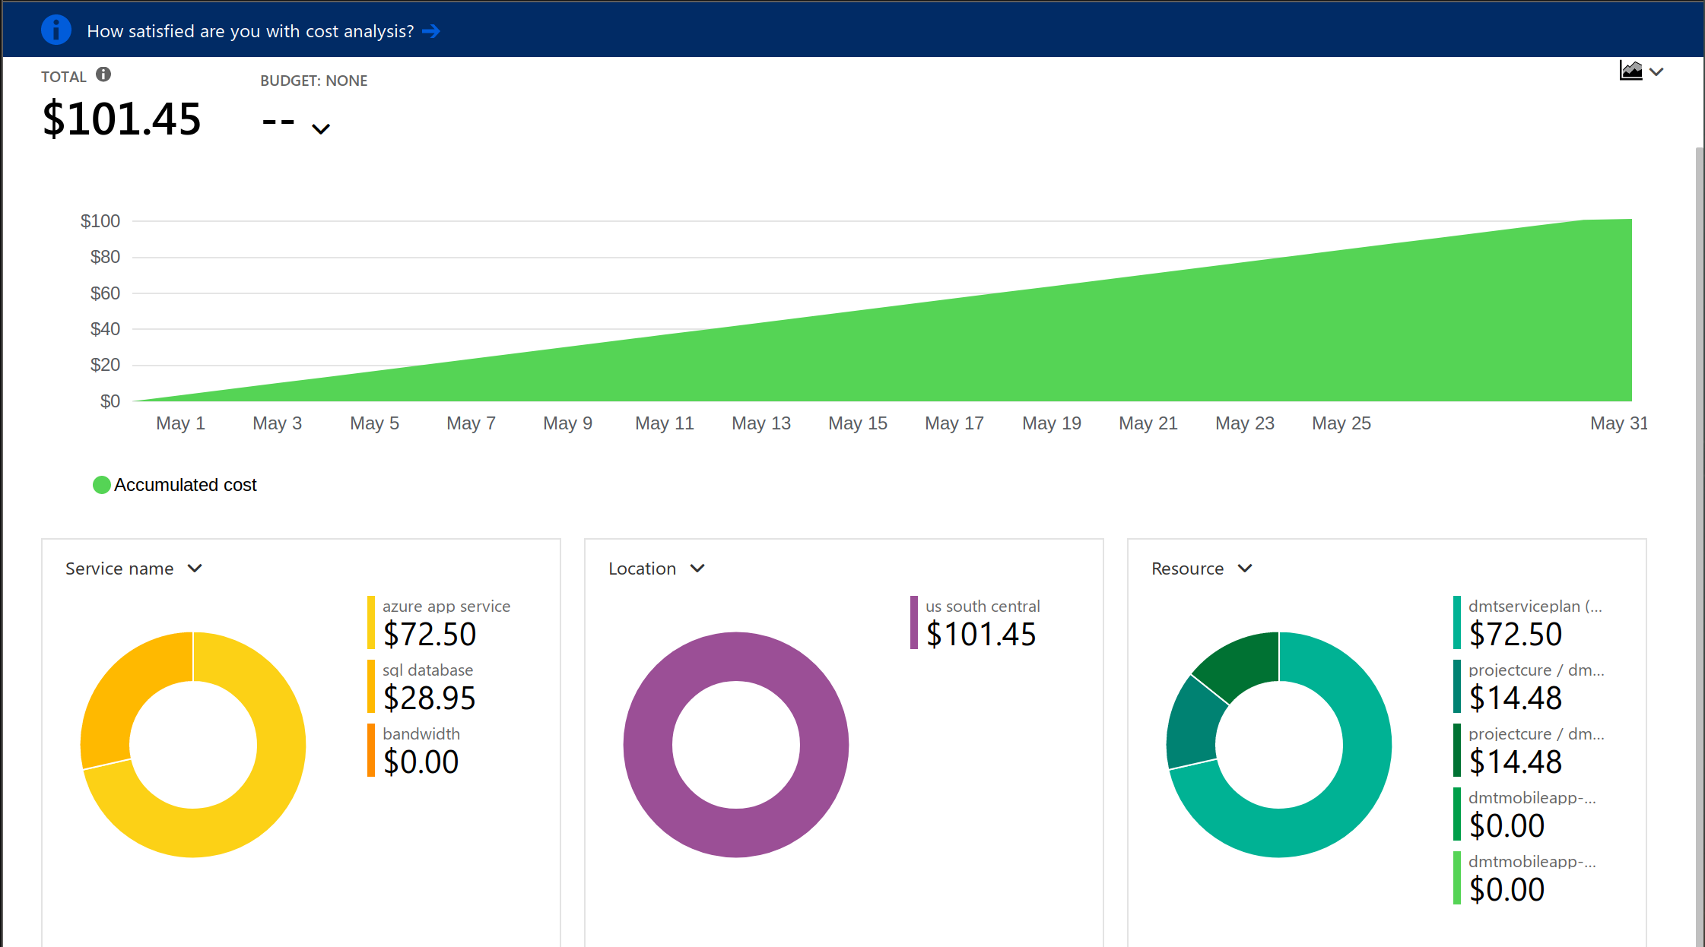
DMT Azure Costs for May 2019
Notes:
Connor

Slide 10
Azure Cost Conclusion
DevelopmentTools and CURESORT
Combined Cost: $390.59
Equipment Tracking and DMT resources
Combined Cost: $183.76
By Archiving unused databases:
New Azure Cost: roughly $390.59 / month
Money Saved: $183.76 / month

Slide 11

Archiving Guide
Unwanted resource groups on Azure:
DMT → 12 Megabytes (MB)
DMTMobileApp → 0 MB
Equipment Tracking → 17 MB
All together these services are costing around $183.76 a month
Archiving resource groups on Azure
Notes:
Lucas

Slide 12

The Solution -- Azure Block Blob Storage
Azure → Industry leading price point for storing rarely accessed data
Block blob storage subscription is used for streaming and storing documents, videos, pictures, backups, and other unstructured text or binary data
Access tier → Archive
Archive: The archive access tier has the lowest storage cost and higher data retrieval costs compared to hot and cool tiers. This tier is intended for data that can tolerate several hours of retrieval latency and will remain in the archive tier for at least 180 days.
While a blob is in archive storage, the blob data is offline and cannot be read, copied, overwritten, or modified. You can't take snapshots of a blob in archive storage. However, the blob metadata remains online and available, allowing you to list the blob and its properties.
Notes:
Lucas

Slide 13

Archive access level -- Blob Storage subscription
Data storage prices:
Archive access tier → For the first 50 terabytes (TB) → $0.002 per gigabyte (GB) of data
Total MB of unwanted services → 29 MB → $0.000058 a month
However, if moved out before 180 days a fee will be charged
Notes:
Lucas

Slide 14
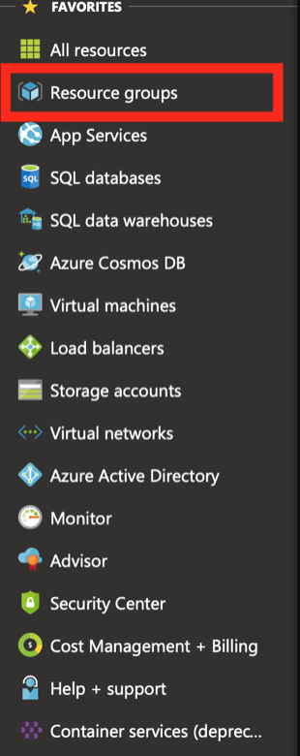
How to archive on Azure
Step 1
Notes:
Lucas

Slide 15
How to archive on Azure
Step 2
Notes:
Lucas

Slide 16
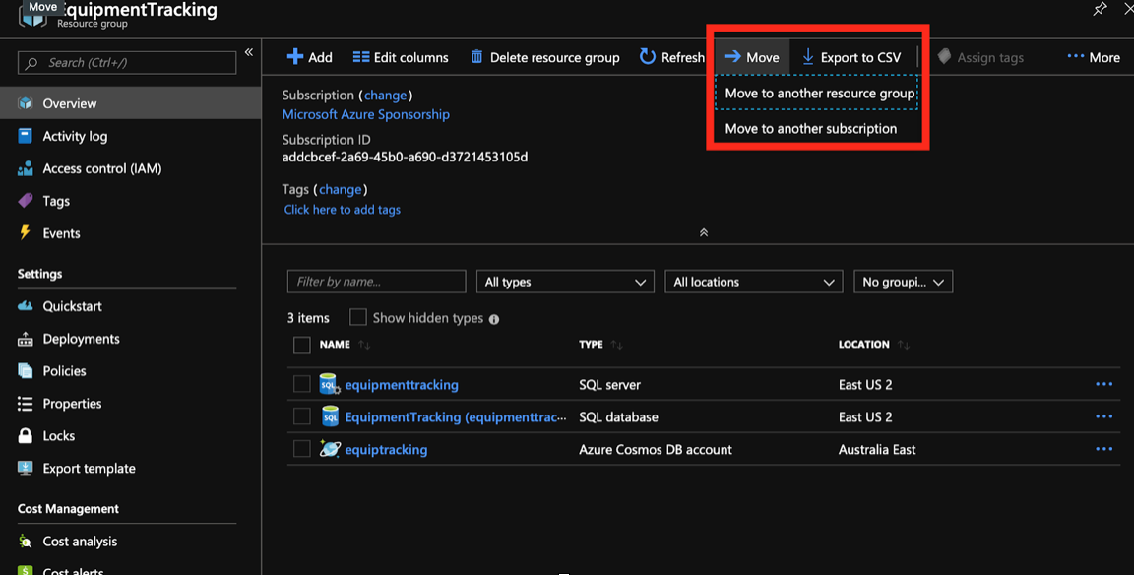
How to archive on Azure
Step 3
Notes:
Lucas

Slide 17
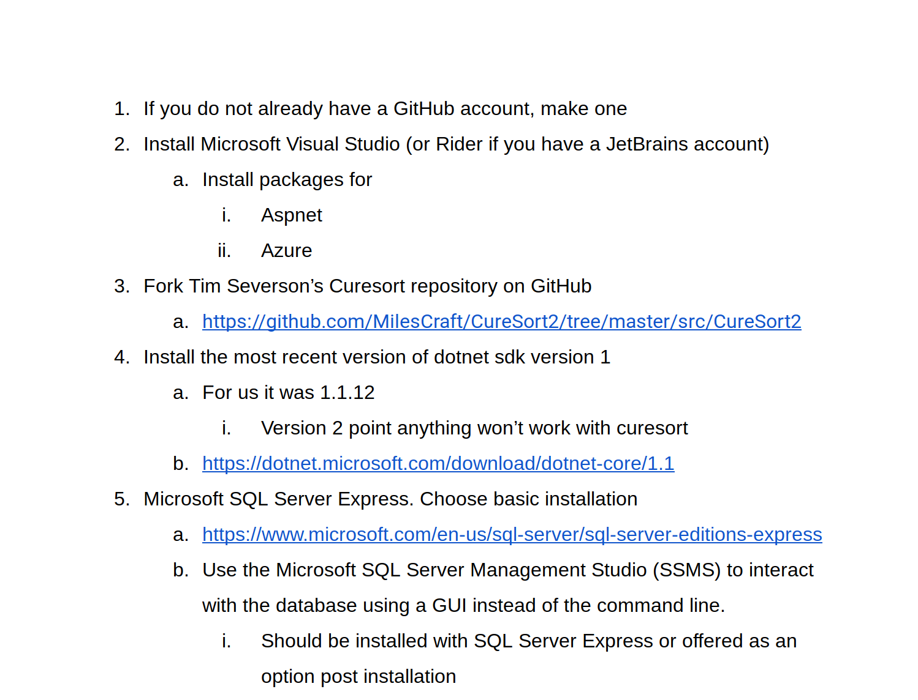

Installation Guide
Notes:
Connor

Slide 18

Installation Guide
Spent the last few weeks working with Tim to create a guide of what we had done on our local machines
Includes links to necessary software
Bundled with an excel file that helps create the database
Should be able to get a new group up to where we were in less than a day
Step-by-Step guide to installing necessary software and getting the project up and running to the extent that we did
Notes:
Connor

Slide 19
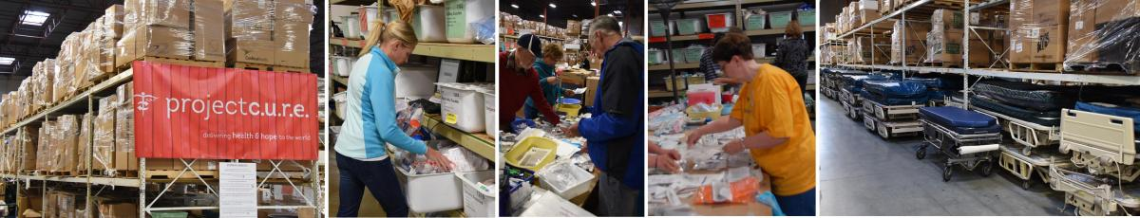
User Stories
&
Volunteer Work
Item look up (Network)
Search quality
Search guide
More admins (more functionality)
More people to update system
Flagging system
Font Size & Front End
Sometimes new volunteers don’t recognize these problems right away
Guides may help these problems
Danielle, Steve, Norma
Notes:
Sam

Slide 20


User Search Guide
Frequent volunteer concern
Feel free to change guide
Was unable to actually test the system
May be useful to have these guides up at each station
https://docs.google.com/document/d/1dYyhpyYz5bqe93IQ16Ggnc9y88VN-6hXpl4NaxzNyHE/edit?usp=sharing
Notes:
Sam

Slide 21
Notes to Tim
Better error reports
Maybe pass to the next team
Font increase
Front end
Wildcard queries
Notes:
Alex

Slide 22
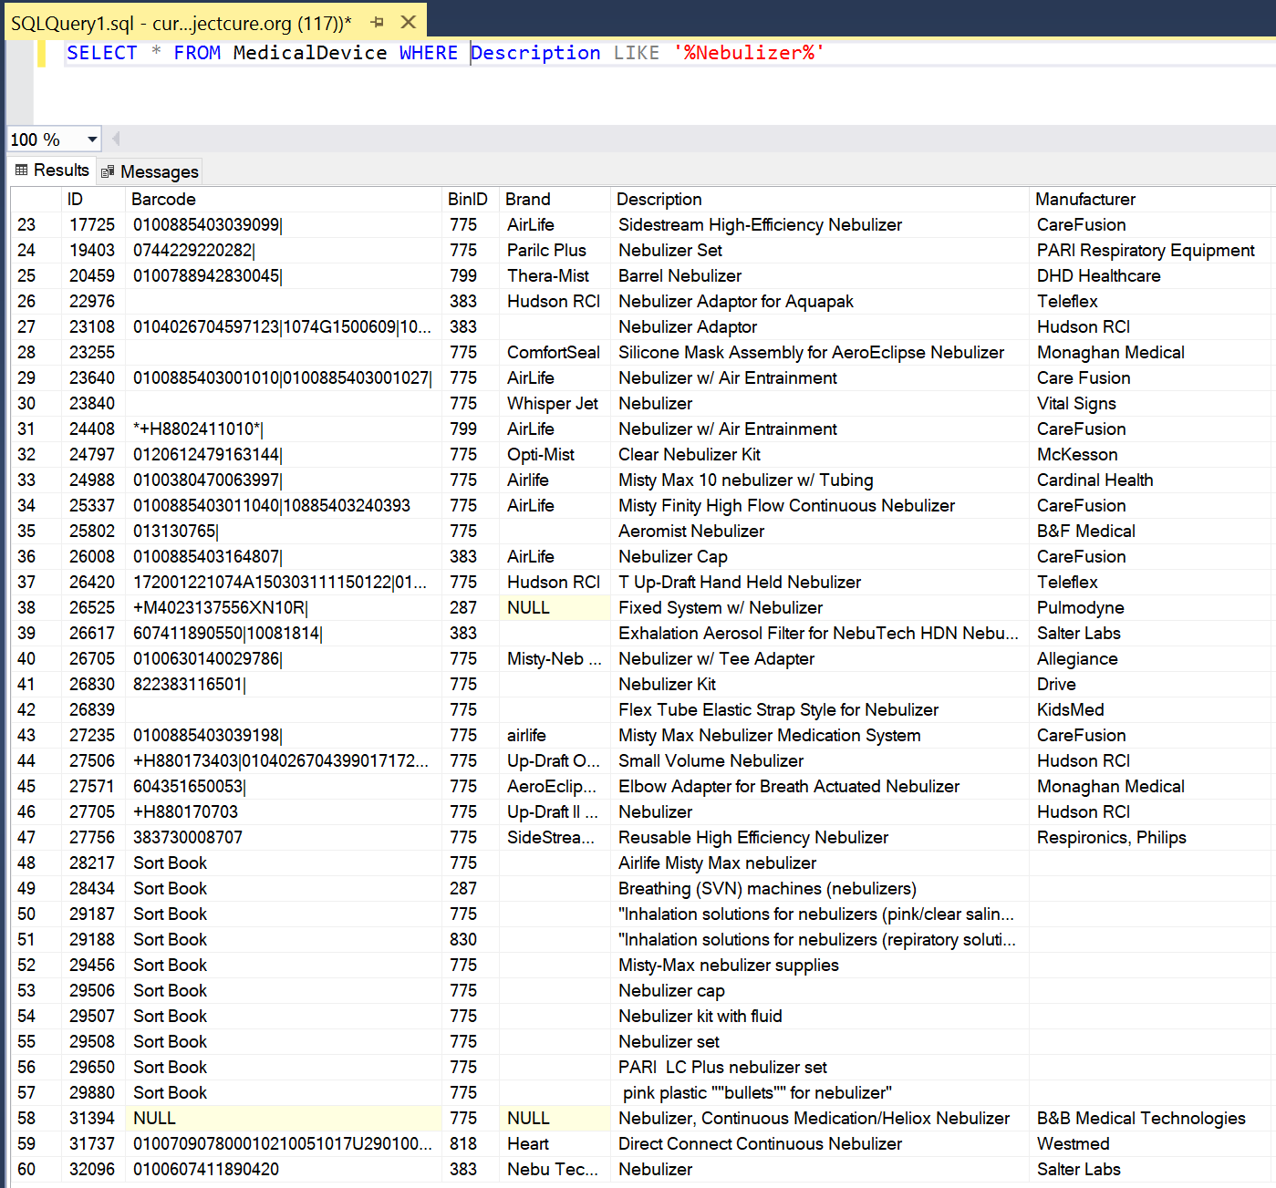
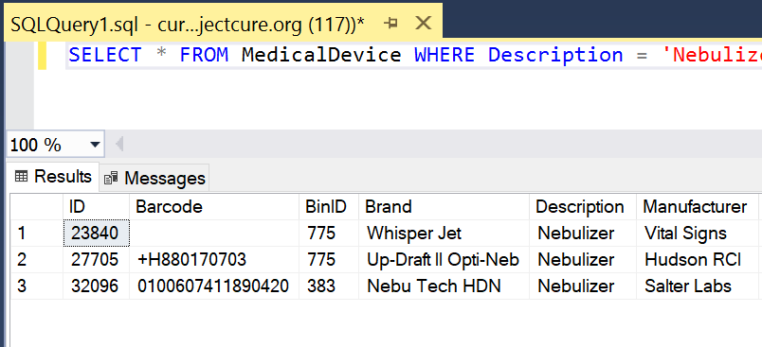
Wildcard Queries
With Wildcard Query
Without Wildcard Query
Notes:
Alex

Slide 23
Wildcard Queries
Very simple change to query statement
Non-Wildcard Query
SELECT * FROM MedicalDevice WHERE Description = ‘Nebulizer’;
Wildcard Query
SELECT * FROM MedicalDevice WHERE Description LIKE ‘%Nebulizer%’;
Returns a wider result set
Possible 20x increase in result set size
Notes:
Alex

Slide 24

Onwards
&
Upwards!
Future team involvement with CURESORT
User interface changes?
Training → educate users on how to use CURESORT
Notes:
Sam

Slide 25

Questions?
Notes:
Sam

